Slide 1
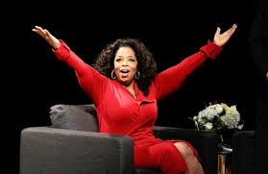
Career Exploration Interviews
Introduction to Asking Good Questions & Preparation for Career Interviews

Slide 2
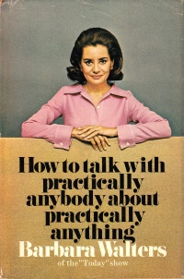
Tips on Conducting an Interview
Jot down some of the interviewing tips that Barbara Walters shares in the video.
Is there anything else that you notice about her questions? Write that down, too!
Notes:
(Beginning to 4:10)
http://abcnews.go.com/Entertainment/barbara-walters-art-interview/story?id=23737829

Slide 3
Tips on Conducting an Interview
Share the tips you wrote down with a neighbor.
Which of these tips would be most important for interviewing a professional for the purpose of learning about a career?

Slide 4
Some Key Interview Tips:
Do your homework
Determine the purpose of your interview
(What do you want to know?)
Prepare lots of questions
Know your questions
Ask open-ended questions
Be a good listener/ take good notes

Slide 5
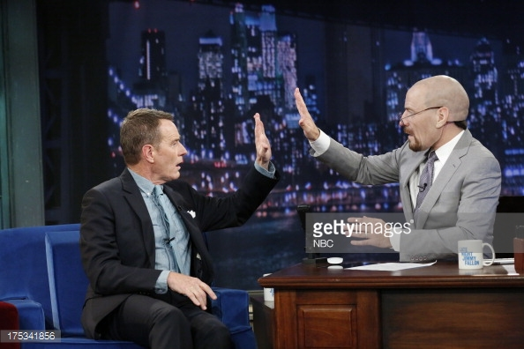
Interview Theater
Lets watch the difference between a successful interview question and an unsuccessful interview question.

Slide 6
Interviewing Practice
Find a partner
Determine your interview objective (What do you want to find out about this person?)
Write down 3 interview questions for your partner

Slide 7
Career Interviewing Brainstorm
 | Profession: | Potential Interview Questions (2 each): | Name & Contact Information:
1. | Graphic Designer | How many graphic designers work freelance vs. salary positions? How did you begin your career? What is your average work day like?
2.
3.

