Slide 1
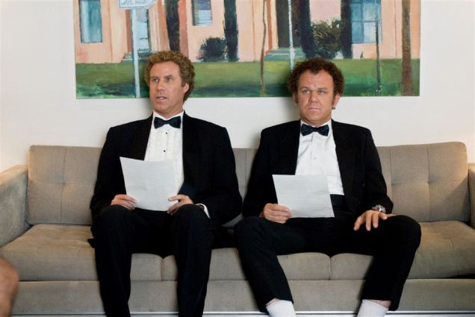
Intro to Resumes

Slide 2
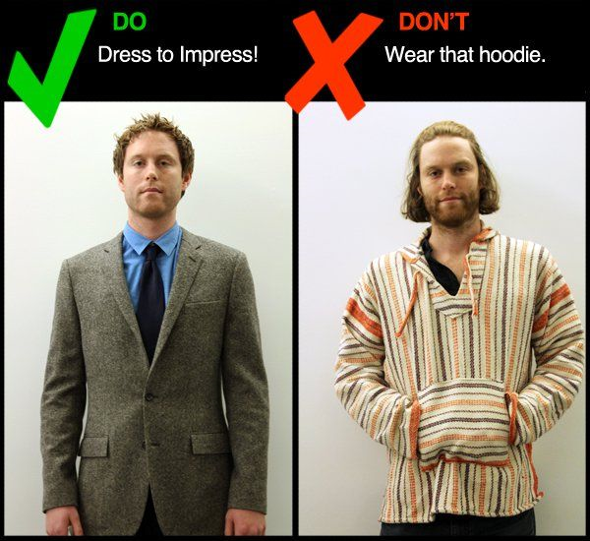
If you had to hire a new worker at your place of employment, who would you hire?

Slide 3
You probably made your decision based on attire, right?
How an applicant dresses/presents themself for an interview says a lot, and employers have to make judgments based upon limited information.
This is why it’s important to present yourself in the best way possible in an interview…

Slide 4
…But before you are even called for an interview, your future employer will be judging you based upon your resume.
You are not guaranteed an interview, so make sure your resume makes a good impression!

Slide 5
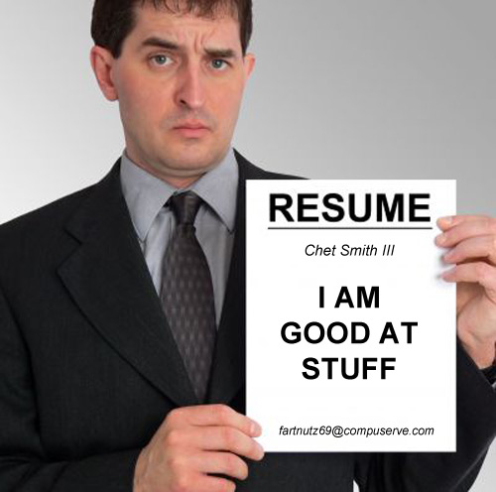
Resumes: Content & Presentation
The purpose of a resume is to present a “snap shot” of your experience, qualifications, and skills to an employer.
The content of the resume is important because it helps the employer decide if you are qualified for the job.
But the way that information is presented is also very important. The care you take in preparing your resume can either convince the employer to call you in for an interview… or throw your resume into the recycling bin.
Resume for Teens 101: http://jobsearch.about.com/video/Write-a-Resume-for-Teens.htm#vdTrn

Slide 6
Exhibit A: What do you think should be edited in this resume?

Slide 8
Exhibit B: What has improved?

Slide 9
Working on your Resume
Choose the appropriate resume template and fill in with your information
Use the Resume Vocab & Tips handout to help improve language
Be sure to proofread your resume. Afterwards, have at least one other pair of eyes look it over. (Mrs. Mound is in room D123.)

